Slide 1

Agile-DB Systel Basics
Neeraj Vohra

Slide 2

Recap….
As a S/W professional , our main goal is developing a S/W, deliver the S/W to the customer and maintain the S/W, ensure that must be used by end users.
S/W is a piece of code serves some business requirements.
To deliver the same, we are following some processes called SDLC models.

Slide 3
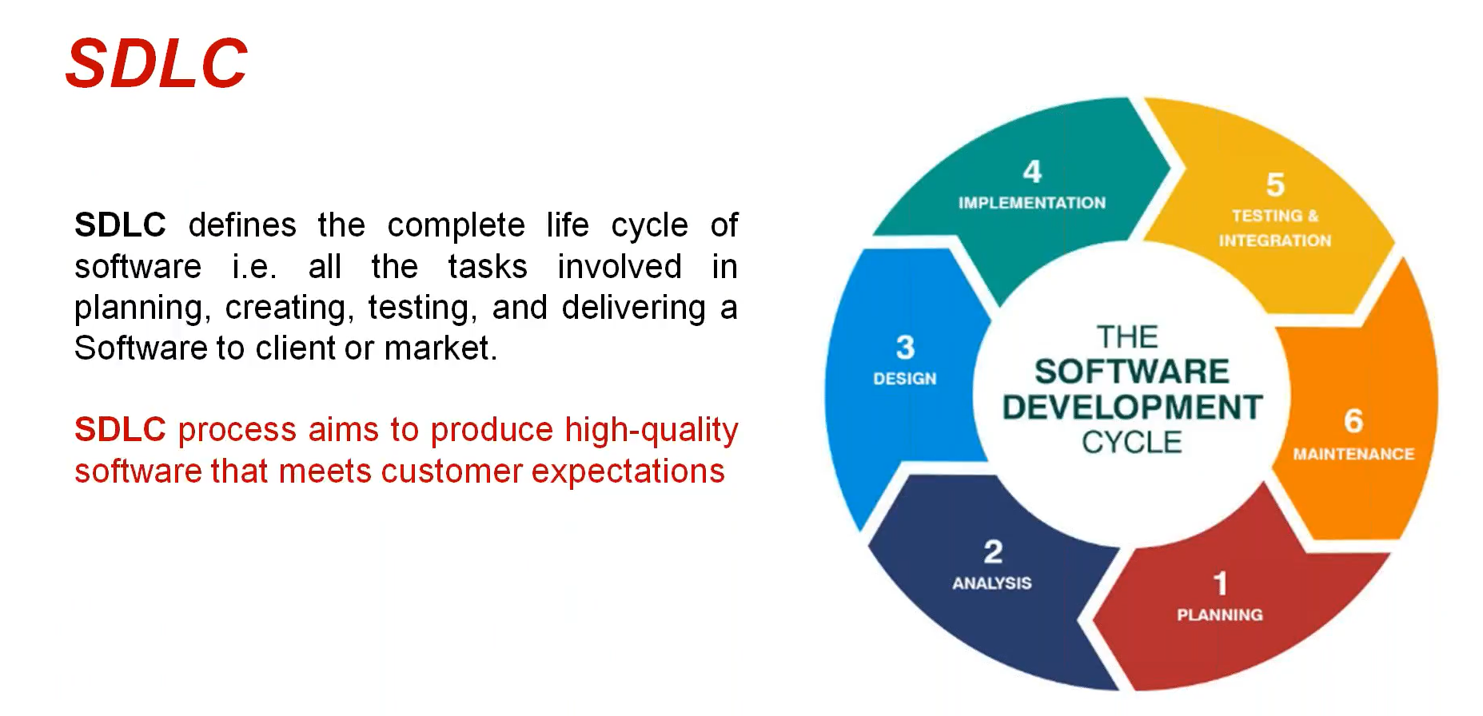
Recap….
Notes:
SDLC defines the complete life cycle of software i.e. all tasks involved in planning, development, testing and delivering a Software to client or market.
SDLC process aims to produce high-quality software that meets customer expectations.

Slide 4
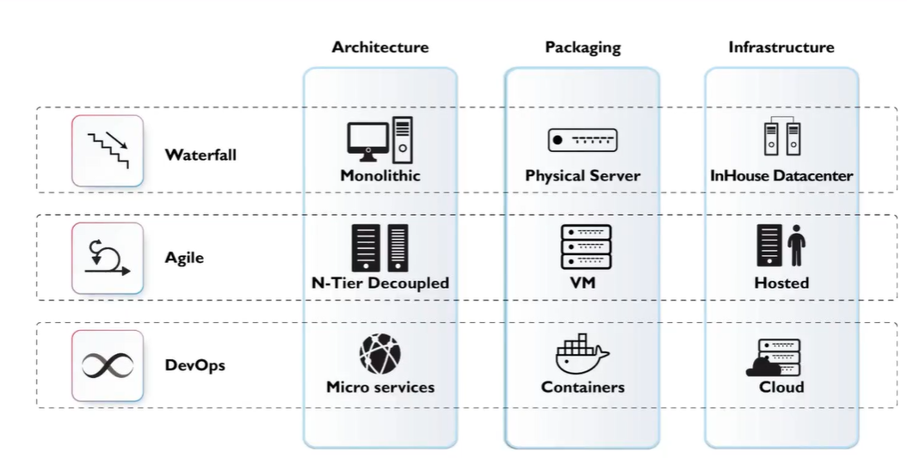
Various SDLC Models
How we are delivering the S/W to the customer over the years.

Slide 5
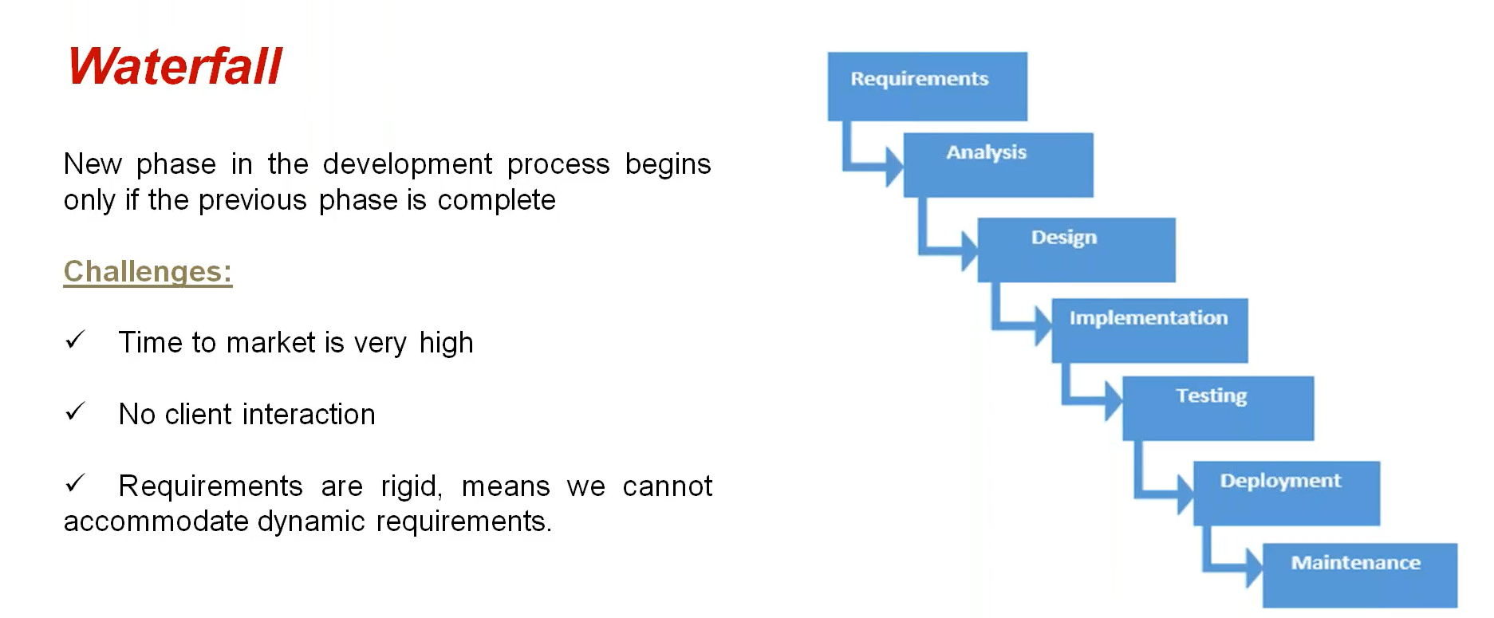
Waterfall

Slide 6
Agile
Rapid
Adaptable
AGILE
Quality-driven
Cooperative
Iterative
Not a process, it's a philosophy or set of values

Slide 7
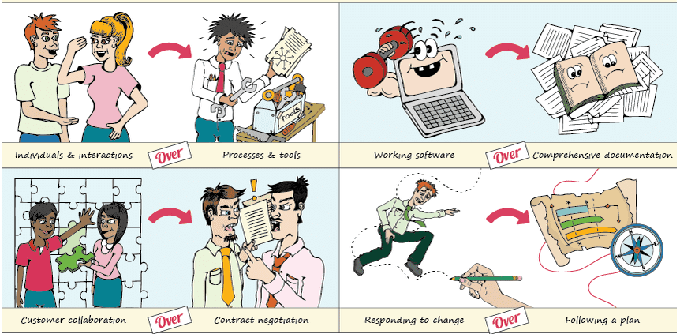
Agile Manifesto
Manifesto: A written statement of the beliefs, aims, and policies of an organization, especially a political party:
We are uncovering better ways of developing software by doing it and helping others to do it .
Through this work we have to come to value.
Our highest priority is to satisfy the customer through early and continuous delivery of valuable software .

Slide 8
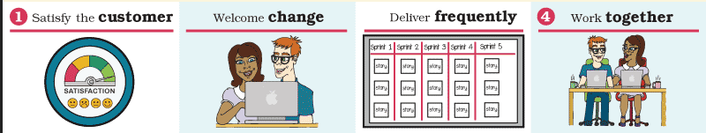
Agile Principles
1. Our highest priority is to satisfy the customer through early and continuous delivery of valuable software.
2. Welcome changing requirements, even late in development. Agile processes harness change for the customer’s competitive advantage.
3. Deliver working software frequently, from a couple of weeks to a couple of months, with a preference for the shorter timescale.
4. Businesspeople and developers must work together daily throughout the project.

Slide 9
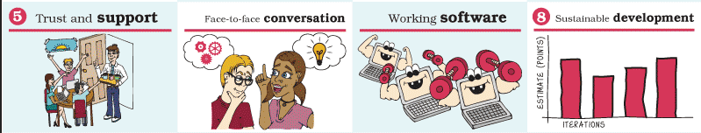
Agile Principles
5. Build projects around motivated individuals. Give them the environment and support they need, then trust them to get the job done.
6. The most efficient and effective method of conveying information to and within the development team is face-to-face conversation.
7. Working software is the primary measure of progress.
8. Agile processes promote sustainable development. The sponsors, developers, and users should be able to maintain a constant pace indefinitely.

Slide 10
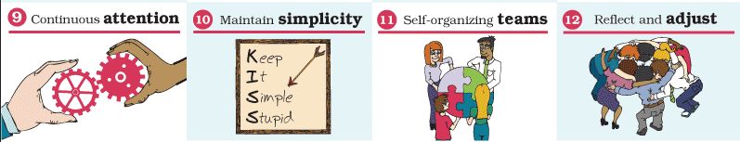
Agile Principles
9. Continuous attention to technical excellence and good design enhances agility.
10. Simplicity — the art of maximizing the amount of work not done — is essential.
11. The best architectures, requirements, and designs emerge from self-organizing teams.
12. At regular intervals, the team reflects on how to become more effective, then tunes and adjusts its behavior accordingly.

Slide 11
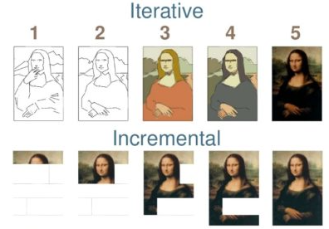
Agile is Iterative and Incremental
Scrum and agile are both incremental and iterative. They are iterative in
that they plan for the work of one iteration to be improved upon in subsequent
iterations. They are incremental because completed work is delivered throughout
the project.

Slide 12
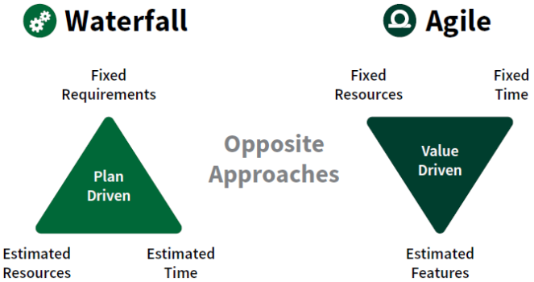
Agile Vs Waterfall

Slide 13
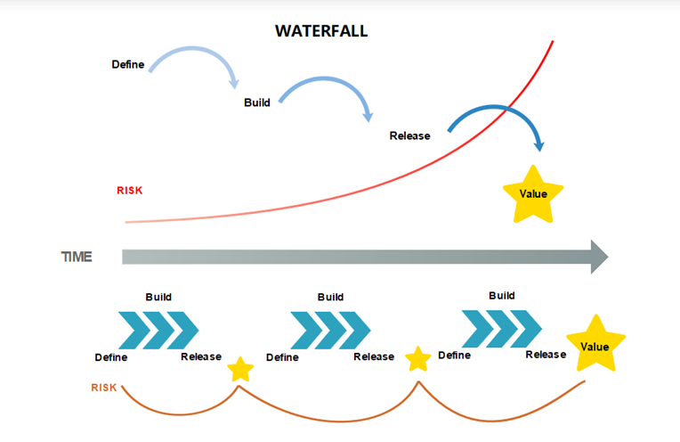
Agile Vs Waterfall

Slide 14
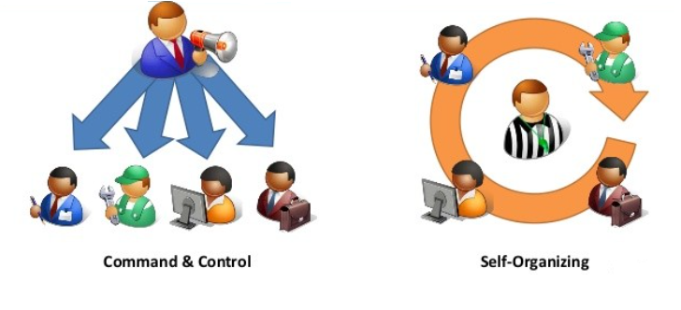
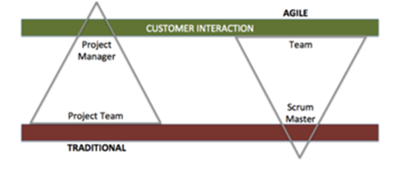
Agile Vs Waterfall (Team)
Notes:
The team will not operate up a hierarchy — instead, it will operate horizontally, with a focus on the customer.
The approach is one of enabling self-organization, and not a controlling set of rules.
Plans are iterative and continuously in flux, rather than static and concrete.
The workplace is an interesting and inspiring area, channeled via people who are given autonomy.
The customer is central, and not absent; the aim of the team is to satisfy the customer’s business needs.

Slide 15
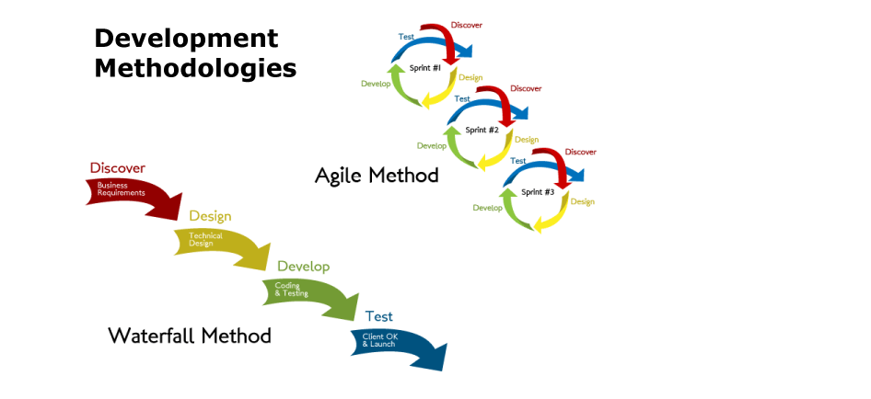
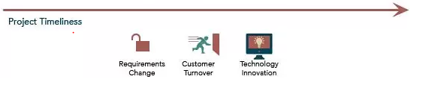
Waterfall Vs Agile Projects

Slide 16
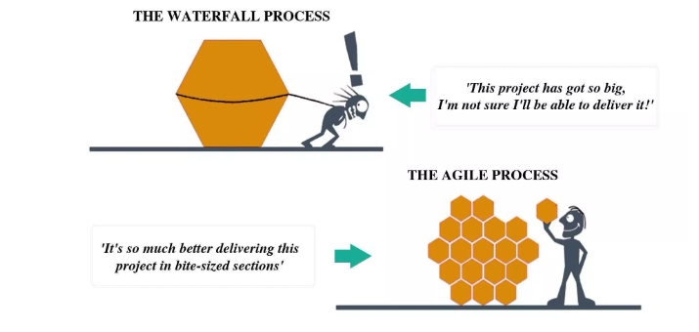
Agile Vs Waterfall Projects

Slide 17
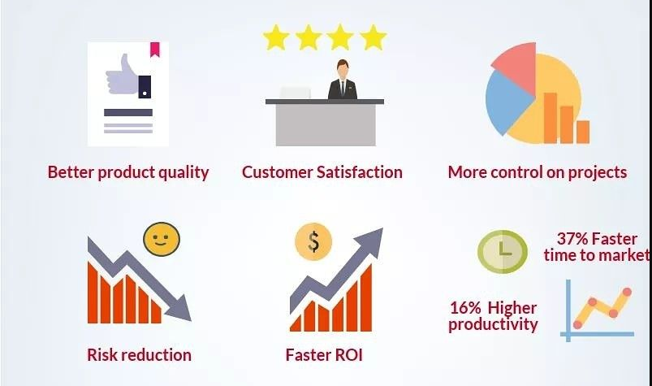
Benefits Of Agile Project Management

Slide 18
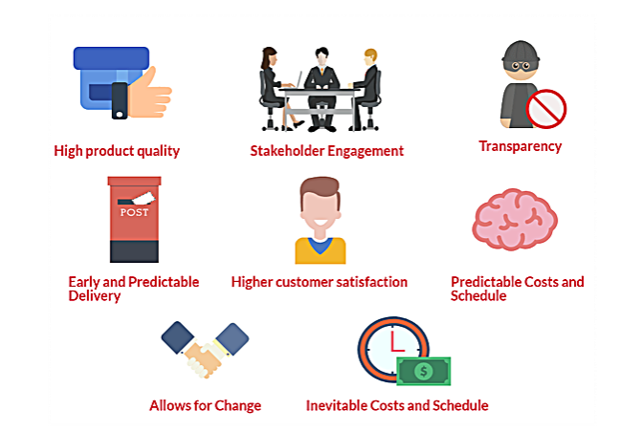
Benefits Of Agile Project Management

Slide 19
Agile- Benefits(High Product Quality)
In Agile development, testing is integrated during the cycle, which means that there are regular checkups to see that the product is working during the development. This enables the product owner to make changes if needed and the team is aware if there are any issues.
Defining and elaborating requirements just in time so that the knowledge of the product features is as relevant as possible.
Incorporating continuous integration and daily testing into the development process, allowing the development team to address issues while they’re still fresh.
Taking advantage of automated testing tools.
Conducting sprint retrospectives, allowing the scrum team to continuously improve processes and work.
Completing work using the definition of done developed, tested, integrated, and documented.
Software is developed in incremental, rapid cycles. This results in small incremental releases with each release building on previous functionality. Each release is thoroughly tested to ensure software quality is maintained.

Slide 20
Agile- Benefits(Higher Customer Satisfaction)
The product owner is always involved, the progress of development has high visibility and flexibility to change is highly important. This implies engagement and customer satisfaction.
Demonstrating working functionalities to customers in every sprint review.
Delivering products to market quicker and more often with every release. The clients get early access to the product during the life cycle.
Keeping customers involved and engaged throughout projects.

Slide 21
Agile- Benefits(Increased Project Control)
Sprint meetings.
Transparency.
Jira usage (visibility of each step of the project for both parties).
Allows for Change
While the team needs to pay attention to distributing an agreed-to subset of the manufactured good’s features during each pass, there is an occasion to constantly purify and reprioritize the general product backlog. Original or changed log jam items can be designed for the next pass, providing the opportunity to initiate alterations within a few weeks.

Slide 22
Agile- Benefits(Reduced Risk)
Agile methodologies virtually eliminate the chances of absolute project failure.
Always having a working product, starting with the very first sprint, so that no agile project fails completely.
Developing in sprints, ensuring a short time between initial project investment and either failing fast or knowing that a product or an approach will work.
Generating revenue early with self-funding projects, allowing organizations to pay for a project with little up-front expense.
Agile gives freedom when new changes need to be implemented. They can be implemented at very little cost because of the frequency of new increments that are produced.
Adaptation to the client’s needs and preferences through the development process. Agile commonly uses user stories with business-focused acceptance criteria to define product features. By focusing features on the needs of real customers, each feature incrementally delivers value, not just an IT component. This also provides the opportunity to beta test software after each iteration, gaining valuable feedback early in the project and providing the ability to make changes as needed.

Slide 23
Agile- Benefits(Faster ROI)
The fact that agile development is iterative means that the features are delivered incrementally, therefore benefits are realized early while the product is in development process.
Development starts early.
A functional ‘ready to market’ product after few iterations.
First Mover Advantage.
Long delivery cycles are often a problem for businesses, particularly those in fast-moving markets.
Agile means fast product releases and ability to gauge customer reaction and alter accordingly, keeping you ahead of the competition.
Focusing on Business value. By allowing the client to determine the priority of features, the team understands what’s most important to the client’s business and can deliver features in the most valuable order.

Slide 24
Stakeholder Engagement
Agile presents multiple prospects for team engagement and stakeholder – after, before, and during each Sprint. By linking the client with each step of the project, there is an elevated amount of collaboration between the project team and client, providing more chances for the team to really understand the client’s perspective. “Bringing working software near the beginning and commonly increases stakeholders’ faith in the team’s capability to deliver high-quality working software and supports them to be more deeply occupied in the project.”
Transparency
An exclusive opportunity for customers to be involved all through the project, from prioritizing characteristics to iteration planning and evaluation sessions to recurrent software builds enclosing new characteristics, these all are provided by agile development. However, this also involves clients to appreciate that they are seeing a job in progress in trade for this added benefit of lucidity.

Slide 25
Early and Predictable Delivery
By means of time-boxed, unchanging schedule Sprints of 1-6 weeks, new attributes are delivered quickly and frequently, with a high level of predictability. This also offers the occasion to release or alpha test the software previous than planned if there is sufficient business value.
Inevitable Costs and Schedule
Because each cycle is a fixed duration, the rate is predictable and partial to the amount of work that can be performed by the team in the fixed-schedule time period. Shared with the estimates provided to the customer prior to each cycle, the client can more gladly understand the estimated cost of each feature, which further improves conclusion making about the precedence of features and the need for additional iterations.
Notes:
Conclusion
Statistics say that by using agile project management, on average, the time to market is 37% faster and the efficiency of you team is increased with a productivity higher by 16% that the average.

Slide 26
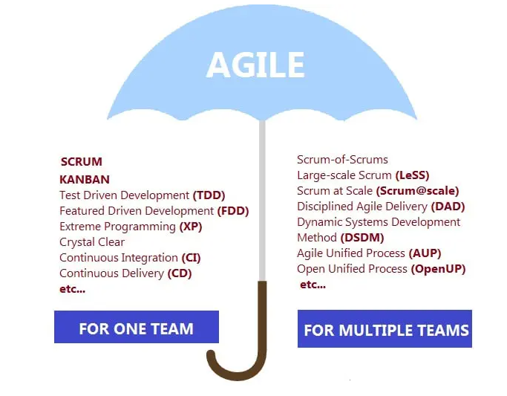
Agile Umbrella

Slide 27

The Scrum Values

Slide 28
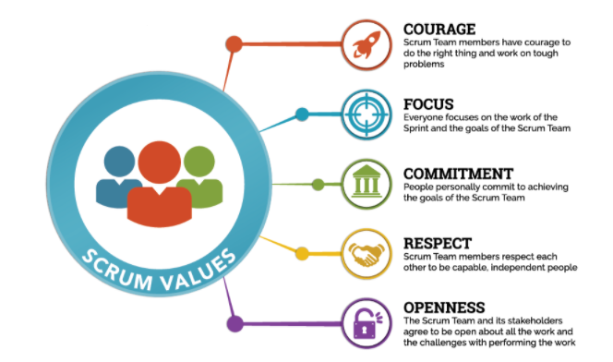
The Scrum Values

Slide 29
The Scrum Values
Commitment:
Committing to something that you don’t understand because you are told to by
your boss instead of committing yourself to the team and Sprint Goal.
Focus:
We focus on what’s most nearby in time as the future is highly uncertain and we
want to learn from the present to gain experience for future work. We focus on
the work to get things done. We focus on the simplest thing that might possibly work.
Openness:
Telling everyone everything about all your work instead of highlighting when you
have challenges and problems that are stopping you from success.
Respect:
Thinking you are helping the team by being a hero instead of helping people to learn
the things that you are good at and not judging the things that others aren’t good at
Courage:
Courage to consider change as a source of inspiration and innovation. Courage to
not deliver undone software. Courage in sharing all possible information (transparency)
that might help the team and the organization. Courage in admitting that nobody is
perfect. Courage to change direction. Courage to share risks and benefits. Courage
to promote Scrum and empiricism to deal with complexity. We show courage to
support the Scrum Values.

Slide 30
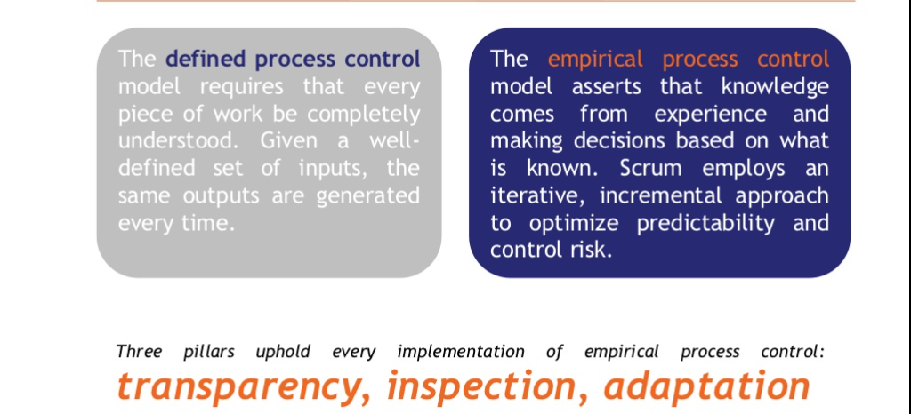
Defined Vs. Empirical Process
Notes:
Empiricism means working in a fact-based, experience-based, and evidence-based manner. Scrum implements an empirical process where progress is based on observations of reality, not fictitious plans. Scrum also places great emphasis on mind-set and cultural shift to achieve business and organizational Agility.

Slide 31
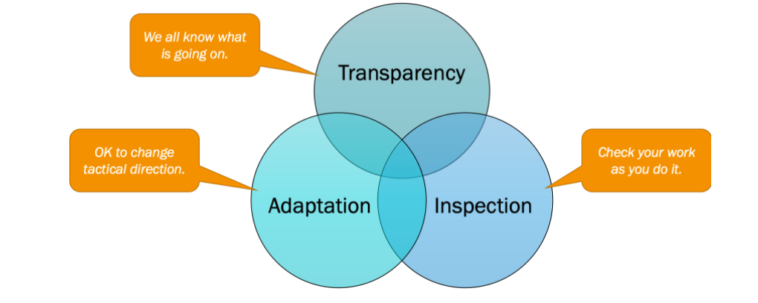
The Three Pillars of Empiricism

Slide 32
The Three Pillars of Empiricism
Transparency: This means presenting the facts as is. All people involved—the customer, the CEO, individual contributors—are transparent in their day-to-day dealings with others. They all trust each other, and they have the courage to keep each other abreast of good news as well as bad news. Everyone strives and collectively collaborates for the common organizational objective, and no one has any hidden agenda.
Inspection: Inspection in this context is not an inspection by an inspector or an auditor but an inspection by every- one on the Scrum Team. The inspection can be done for the product, processes, people aspects, practices, and continuous improvements. For example, the team openly and transparently shows the product at the end of each Sprint to the customer in order to gather valuable feedback. If the customer changes the requirements during inspection, the team does not complain but rather adapts by using this as an opportunity to collaborate with the customer to clarify the requirements and test out the new hypothesis.
Adaptation: Adaptation in this context is about continuous improvement, the ability to adapt based on the results of the inspection. Everyone in the organization must ask this question regularly: Are we better off than yesterday? For profit-based organizations, the value is represented in terms of profit. The adaptation should eventually relay back to one of the reasons for adapting Agile—for example, faster time to market, increased return on investment through value- based delivery, reduced total cost of ownership through enhanced software quality, and improved customer and employee satisfaction.

Slide 33
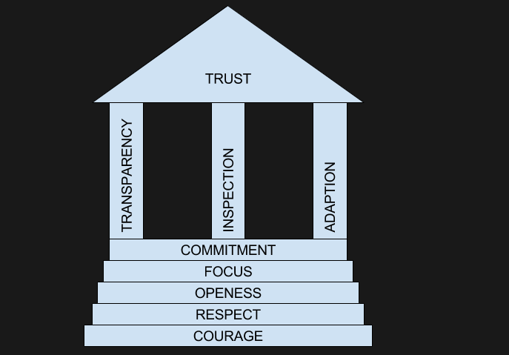
The Scrum Pillars and Values

Slide 34
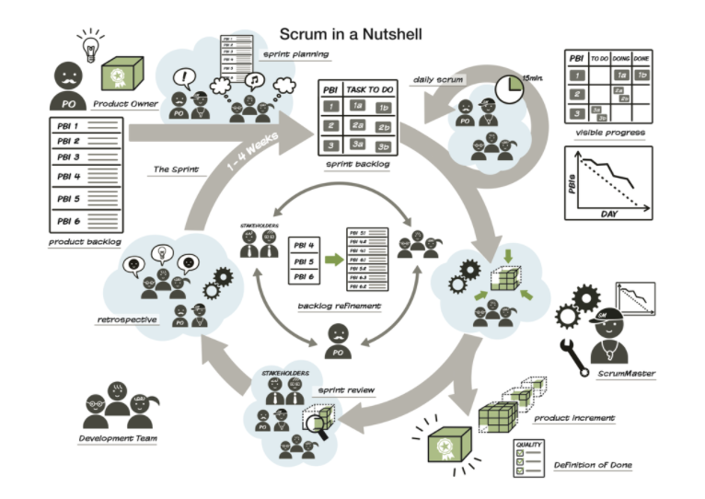
Scrum-In Nutshell
Notes:
Scrum is an adaptive project management framework that enables organizations and project teams to efficiently develop new products or services in iterations, so that they can adapt quickly to customer feedback and as a result, deliver better projects.
In general, Scrum cares most about building the right thing. If we deliver something that isn’t of value, who cares that we deliver it fast or with a high degree of technical excellence? It would have been better to never have delivered it at all.
Once we know we are building the right thing, then Scrum cares about building it fast and building it in the right way.

Slide 35
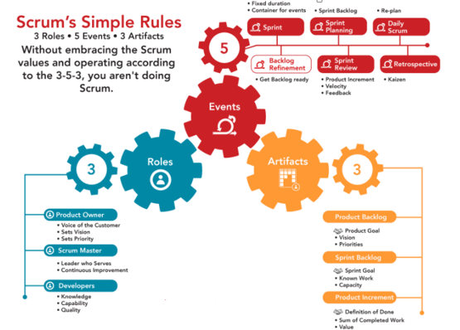
Scrum Framework

Slide 36
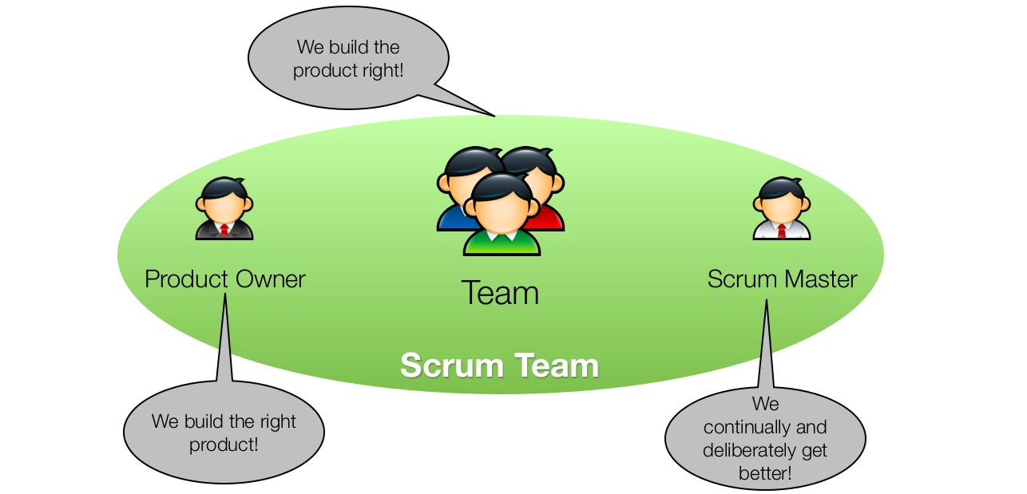
Scrum- Roles(Team)
Notes:
Scrum Team:
PO: Manages the Product Backlog
Dev Team: Creates “Done” Increment.
Scrum Master: Manages the Scrum Processes, Remove Impediments
Self-organizing teams choose how best to accomplish their work, rather than being directed by others outside the team.
Cross-functional teams have all competencies needed to accomplish the work without depending on others not part of the team. The team model in Scrum is designed to optimize flexibility, creativity, and productivity

Slide 37
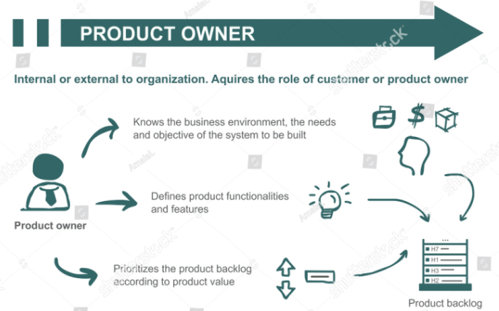
Scrum- Roles(PO)
Notes:
The Product Owner is responsible for communicating product vision. They prioritize the Product Backlog and clarify requirements for the team. The Product Owner makes the decision to accept or reject each product increment and whether or not it is “shippable.”
Product Owner ensures that the Product Backlog items are transparent & clearly expressed and everyone in the team holds the same understanding of the item.
Anyone who wants to add/remove an item in the Product Backlog or needs to change the priority of an item should be directed to the Product owner
.

Slide 38
Scrum- Roles(PO)
The Product Owner is responsible for the features and the ROI of the product.
Manages the requirements in the product backlog.
By making the Product Backlog visible to everyone , the product owner ensures the development team works on the “right things” from the business perspective.
Identifies what has been done and what has not been done in a Sprint.
The product owner is a person not a committee and is authorized to make definite decisions about the product, its features and the order of the implementation.
In short, we can say that the Product Owner is the bridge between the business part and the technical part of the project. Therefore, he is the link between the client and the development team. The Product Owner carries the vision of the Scrum product. Fully integrated to the Scrum team, he is responsible for writing user stories and for keeping the Product Backlog up to date.

Slide 39
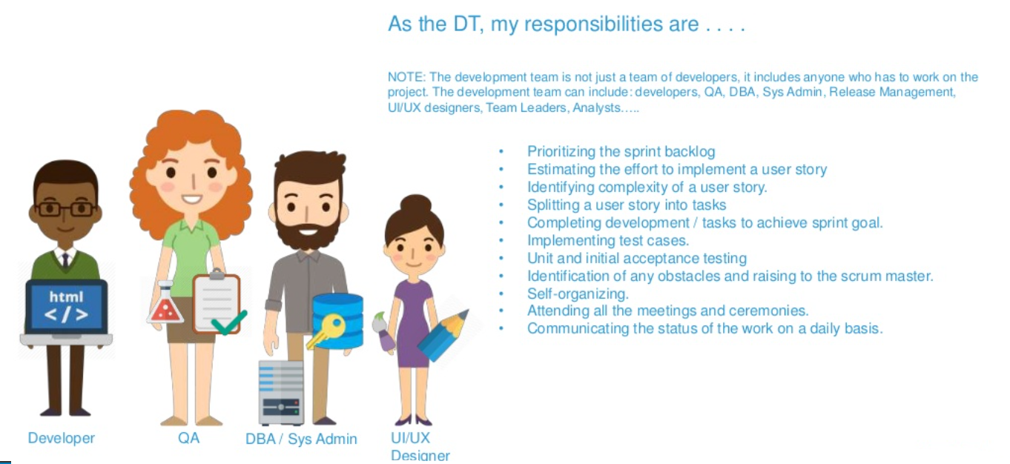
Scrum- Roles(Dev Team)

Slide 40
Scrum- Roles(Dev Team)
Development and Delivery – The Development Team is responsible for creating a done increment based on the ‘Definition of Done’ at the end of each sprint. The done Increment may not necessarily be a part of the next production release, but it is definitely a potentially releasable functionality that an end user can use.
Tasking and Providing Estimations – The Development Team is also responsible for picking up the User Stories/Items from the prioritized Product Backlog to be delivered in the next Sprint. Thus, these Items then constitute a Sprint Backlog. Sprint Backlog is created during a Sprint Planning meeting.
Another very important responsibility that a Development Team does is to create tasks by breaking down the Sprint Items and providing estimates to these Sprint Items.
Nobody tells the Development Team what and how to do things. It is the Development Team’s responsibility to pick up the items from the Product Backlog that can be delivered in the next Sprint. Once the Sprint is started, the items cannot be changed/added/removed.
They stay accountable to work on the Sprint Items.

Slide 41
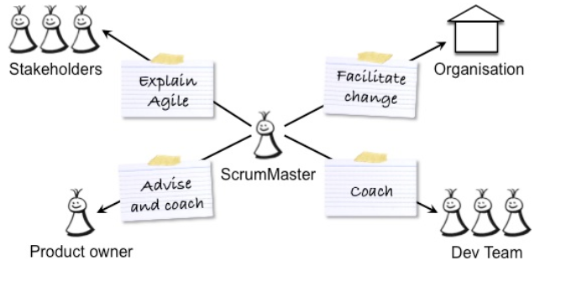
Scrum- Roles(Scrum Master)
Notes:
Scrum Master is a Process Leader who helps the Scrum Team and the others outside the Scrum Team to understand Scrum Values, Principles, and Practices.
Scrum Master is responsible to protect the team from outside interference and for removing the impediments in order to let the team focus on delivering the business value.

Slide 42
Scrum- Roles(Scrum Master)
Coach – The Scrum Master acts as an Agile Coach for both the Development team and the Product Owner. The Scrum Master in a way acts as an enabler for proper communication between the Development Team and the Product Owner.
Facilitator – The Scrum Master also acts as a facilitator for the Scrum Team. He facilitates and organizes all the Scrum Events requested by the Scrum Team Members. The Scrum Master also facilitates the Team in making important decisions that would increase the productivity of the Scrum Team as a whole.
The Scrum Master never orders the Team Members to do something rather, he helps them in achieving it by coaching and guiding.
Removing Impediments – The Scrum Master is also responsible for removing the impediments that impact the team’s productivity in delivering business. Any impediment that the team members cannot resolve on their own comes to the Scrum Master for resolution.
The Scrum Master prioritizes these impediments based on their impact on the team’s productivity and business and starts working on them.

Slide 43
Scrum- Roles(Scrum Master)
Interference Gatekeeper – The Scrum Master also safeguards the Scrum Team from outside interference and distraction so that the team can remain focused on delivering the best value to the business after every sprint.
The interference can be of a greater concern if the team is working in a Scaled Scrum environment where multiple Scrum Team is working together and have the dependencies amongst them.
Servant Leader – The Scrum Master is often referred to as a Servant Leader of the Scrum Team. One of his most important responsibility is to ask the Scrum Teams for their concerns and to make sure that they are addressed.
Process Improver – The Scrum Master along with the team is also responsible for regularly improvising the processes and practices employed to maximize the value being delivered

Slide 44
Scrum – Ceremonies (Events)
This Agile approach requires self-organizing teams that can quickly solve challenges in unpredictable environments. Holding Scrum meetings provides regular communication and transparency in these conditions.
The most important element to Scrum and Agile is the enthusiasm for communication, openness and transparency. These factors underpin everything we do in our daily work using Agile and Scrum practices; they are why we value customer collaboration over contract negotiations and why we’re not afraid to respond to change as we know that feedback is important.
Agile approaches only asks that we learn from our mistakes and/or identify new ways to improve. As one of the principles of the Agile Manifesto states: "At regular intervals, the team reflects on how to become more effective, then tunes and adjusts its behaviors accordingly.”
It is with this call for open communication that Scrum encourages us to hold five key events during a Sprint, all intended to help us work efficiently and closely together, as well as to improve our knowledge and become more effective in the future.

Slide 45
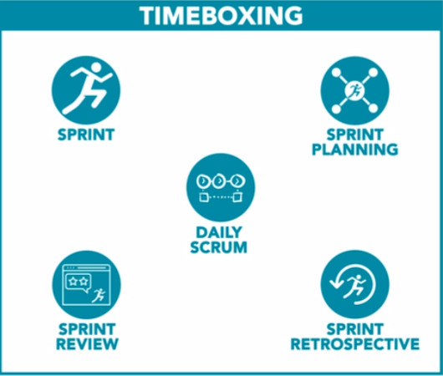
Scrum – TIMEBOXING

Slide 46
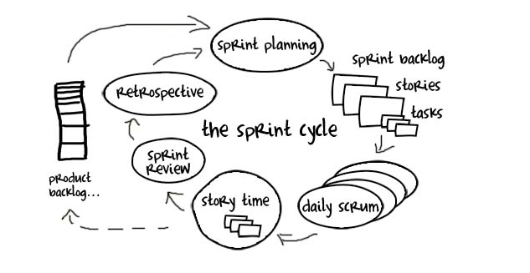
Scrum – Ceremonies (Sprint Cycle)
Notes:
The Sprint is an event that contains all the work and all the other events that happen during the time boxed period of development.

Slide 47
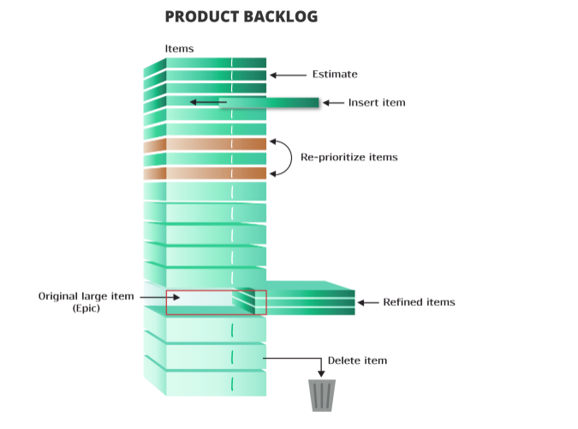
Scrum Ceremony #1: Product Backlog Grooming
Notes:
Backlog grooming is the only ceremony in scrum that doesn’t have a defined time box or even a frequency. It is, however, a critical responsibility of the product owner with the help of their team to add new items to the list and order them based on their priority. At the same time, outdated, redundant or non-valuable items should be removed from the backlog to keep it clean, valuable and actionable.
Most Scrum teams participate in a Backlog grooming meeting (also known as a refinement) once per sprint. This ceremony is a recurring event for Agile development teams.
The key goal of the refinement session is to ensure that the next few sprints worth of user stories are prepared for Sprint Planning. It also guarantees that the right stories are prioritized.
During the Backlog Grooming, teams usually:
discuss user stories
break down large user stories into smaller ones
answer any questions to smooth out any ambiguity
ensure that upcoming user stories meet the definition of readiness

Slide 48
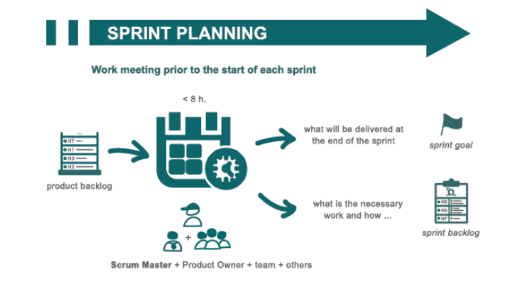
Scrum Ceremony #2: Sprint Planning
Notes:
This is the event that kick starts each Sprint and is where the Product Owner and Development team discuss which Product Backlog Items (PBI’s) will be included in Sprint. While the Product Owner has the right to prioritize each PBI for potential inclusion in the Sprint, the Development team are encouraged to respond, raise issues and push back where necessary. The Development Team then forecasts how many PBI’s they can deliver in the Sprint, given their knowledge of velocity, resources and any factors which could influence the time and resources they have available.
The outcome of the Sprint Planning Meeting is to get a Sprint Goal and Sprint Backlog that everyone agrees is realistic and achievable.

Slide 49
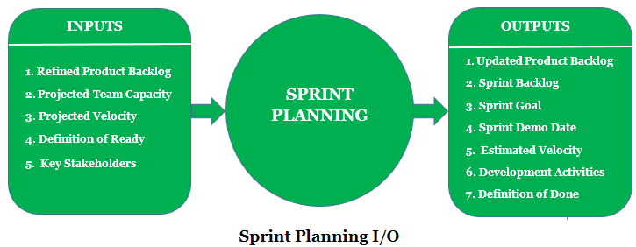
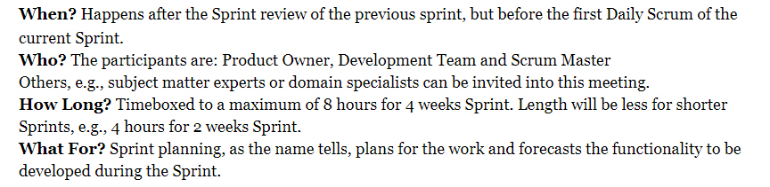
Scrum Ceremony #2: Sprint Planning

Slide 50
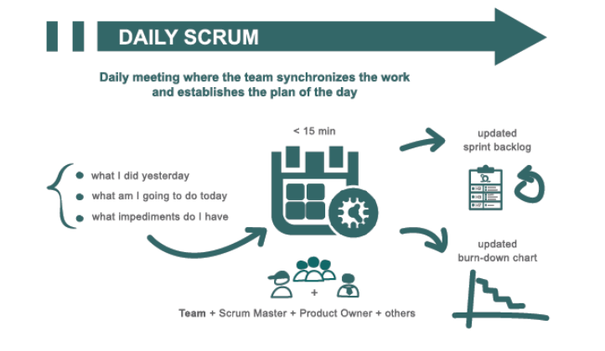
Scrum Ceremony #3: Daily Scrum /Daily Standup
Notes:
Scrum seeks to efficiently use your time and resources and the Daily Scrum event is no exception. The Daily Scrum is time boxed to 15 minutes. Standing up is not compulsory. However, many teams find this a useful technique to keep the meeting short and to the point.
The Daily Scrum is an opportunity for the Development Team to check in, assess progress towards achieving the Sprint Goal and to review and plan their activities for the next 24 hours.

Slide 51
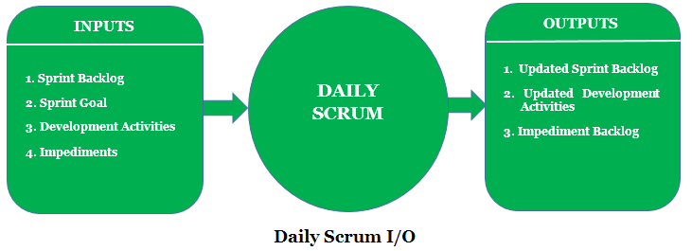
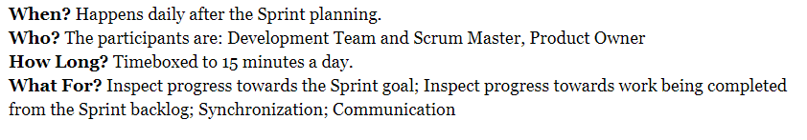
Scrum Ceremony #3: Daily Scrum /Daily Standup

Slide 52
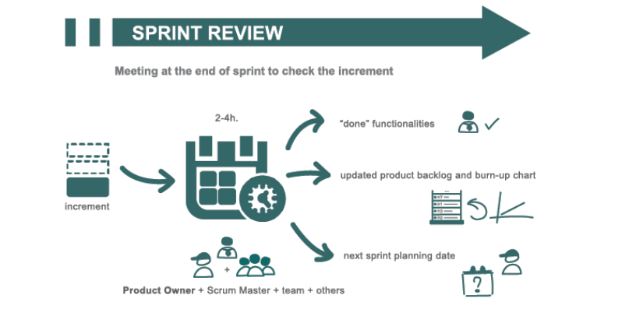
Scrum Ceremony #4: Sprint Review
Notes:
A Sprint Review usually takes place on the last day of the Sprint and allows you the opportunity to show the “done” Increment to stakeholders (customers, management and anyone else considered relevant and interested). As well as demonstrating working features produced during the Sprint, you’re also after useful feedback that can be incorporated the Product Backlog that may help guide the work for future sprints.

Slide 53
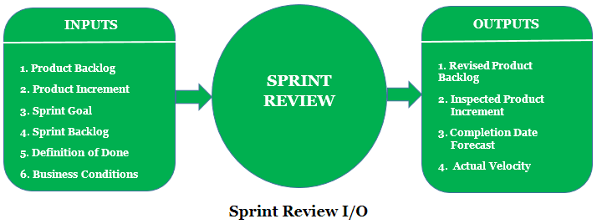
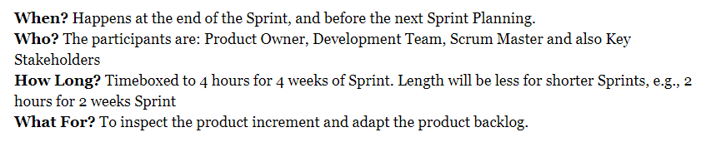
Scrum Ceremony #4: Sprint Review

Slide 54
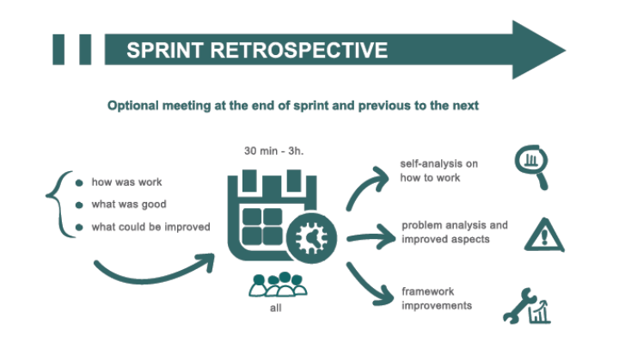
Scrum Ceremony #5: Sprint Retrospective
Notes:
The final meeting in the Sprint is the Sprint Retrospective. This is when the Scrum team reviews what could be improved for future Sprints and how they should do it. The ethos of Scrum dictates that no matter how good the Scrum team is, there will always be opportunity to improve and the Sprint Retrospective gives the team a dedicated time in which to identify, discuss and plan this. The whole Scrum Team should take part including the Development Team, the Scrum Master and the Product Owner. The meeting should be a collaborative effort, just like the entire Scrum and Agile process.

Slide 55
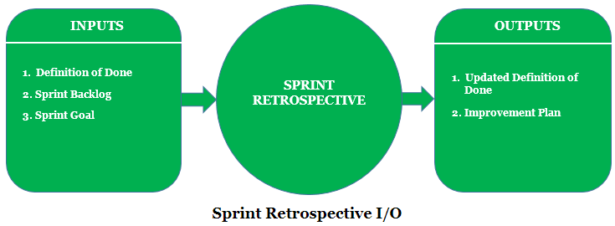
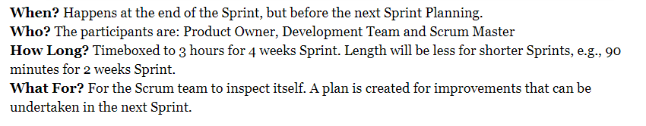
Scrum Ceremony #5: Sprint Retrospective

Slide 56
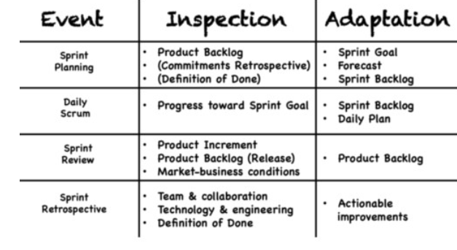
Scrum Ceremony : Inspection Adaptation

Slide 57
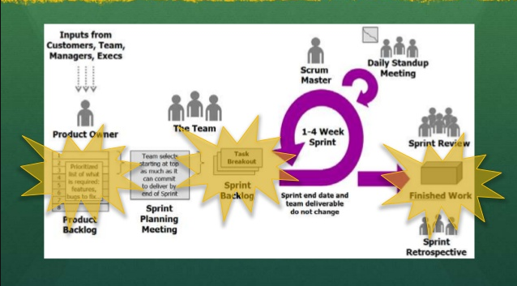
Scrum – Artifacts
Notes:
Scrum’s Artifacts represents work or value to provide transparency and opportunities for inspection and adaptation.
Artifacts defined by scrum are specifically designed to maximize transparency of key information so that everybody has the same understanding of the artifacts.

Slide 58
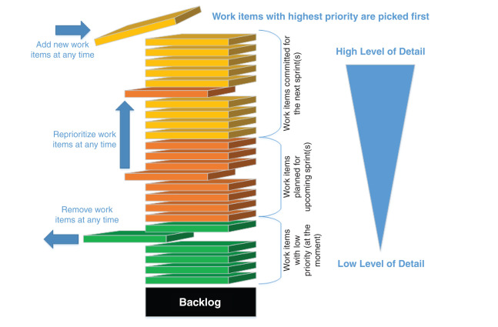
Scrum – Artifacts#1 Product Backlog
Notes:
What is a Product
Product Backlog is really the king, because none of these Scrum-related actions couldn’t happen without it.
A product is something of Value that a customer would be willing to pay for and something “we” would be willing to “package” up and sell.

Slide 59
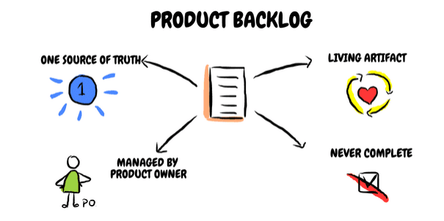
Notes:
The Product Backlog is an ordered list of everything that is known to be needed in the product.
First of all, it is one source of truth that will tell you what is required for a product.
The Product Backlog lists all features, functions, requirements, enhancements, and fixes that constitute the changes to be made to the product in future releases.

Slide 60
Scrum – Artifacts#1 Product Backlog
What is a Product
A product is something of Value that a customer would be willing to pay for and something “we” would be willing to “package” up and sell.
What is a Product Backlog
It is the ordered list that is the single source of everything that is needed for the product.
It is the living artifact that is updated wherever changes occur, and it exists as long as the product exists.
Product Owner is responsible for managing the Product Backlog: content, order, priority etc.
Product Backlog is not fixed - it is never complete.
Product Backlog can contain: Epic, Feature, User Story, Task, Bug.
Product Backlog refinement is done to update some details of the Product Backlog. It should not take more than 10% of the Development Team’s capacity.
The highest ordered items in the Product Backlog should be more detailed to be “Ready” for the Development Team to start working on them.

Slide 61
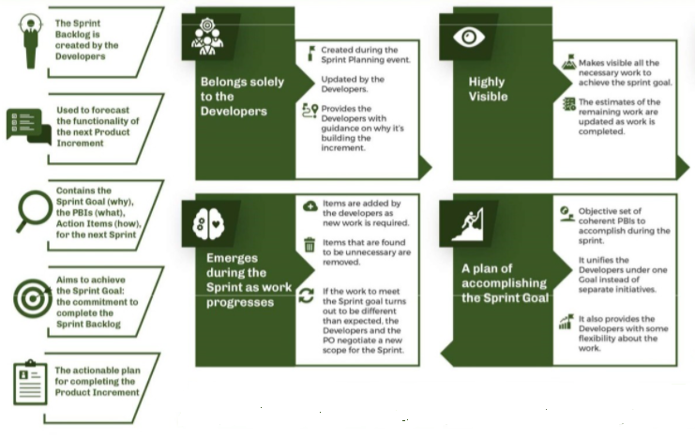
Scrum – Artifacts#2 Sprint Backlog
Notes:
If Product Backlog is a king or queen of the Scrum Artifacts, Sprint Backlog can be called their beloved child.
The Sprint Backlog is the set of Product Backlog items selected for the Sprint, plus a plan for delivering the product Increment and realizing the Sprint Goal.
The Sprint Backlog makes visible all the work that the Development Team identifies as necessary to meet the Sprint Goal.

Slide 62
Scrum – Artifacts#2 Sprint Backlog
It is set of Product Backlog items selected for the Sprint plus delivery plan
Sprint Backlog is created during the Sprint Planning session.
It promotes transparency and supports commitment.
During Sprint Retrospective, at least one improvement should be selected and included in the Sprint Backlog.
Sprint Backlog solely belongs to the Development Team.
Sprint Backlog is a great tool for tracking of daily progress.

Slide 63
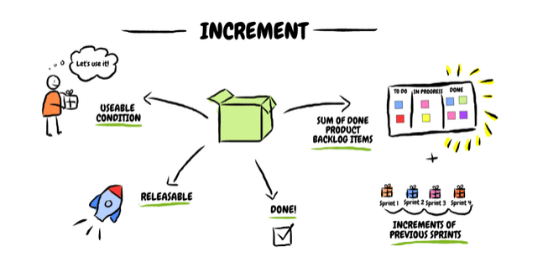
Scrum – Artifacts#3 The Increment
Notes:
Artifacts in Scrum which is the result of all actions in the sprint - the Increment.
The Increment is the sum of all the Product Backlog items completed during a Sprint and the value of the increments of all previous Sprints

Slide 64
Scrum – Artifacts#3 The Increment
Increment is sum of all items completed within the Sprint + value of increments from previous iterations.
When Increment is created, definition of “Done” needs to be met.
Decision about releasing the Increment is in the Product Owner’s hands, but it needs to be in useable/releasable state.
Done=“Potential Shippable”

Slide 65
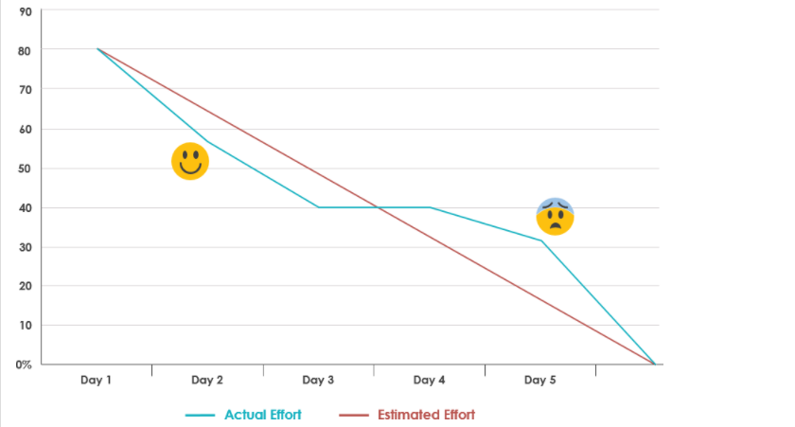
Scrum – Artifacts#4 Burndown Chart
Notes:
A burn down chart is a graphical representation of work left to do versus time. (remaining)

Slide 66

Burndown Chart- Example
Duration: 5 days
Sprint Backlog: 8 tasks
Velocity: 80 available hours
X-Axis | The project/iteration timeline
Y-Axis | The work that needs to be completed for the project. The time or story point estimates for the work remaining will be represented by this axis.
Project Start Point | This is the farthest point to the left of the chart and occurs at day 0 of the project/iteration.
Project End Point | This is the point that is farthest to the right of the chart and occurs on the predicted last day of the project/iteration

Slide 67

Scrum – Artifacts#5 Burnup Chart
Notes:
It is a visual representation of a team’s work process. It displays the scope of a project and the work completed.
A burn-down chart shows the amount of work remaining on a project (the remaining effort), whereas a burn-up chart shows how much work has been completed and the total scope of the project. In a burn-down chart, the line goes from top to bottom as a team makes progress, while in a burn-up chart the line climbs from the bottom upwards. Both charts use the same axis.

Slide 68
Thank You

